Slide 1
Question-2 about design of Future Smith
Dejan
09/28/18

Slide 2
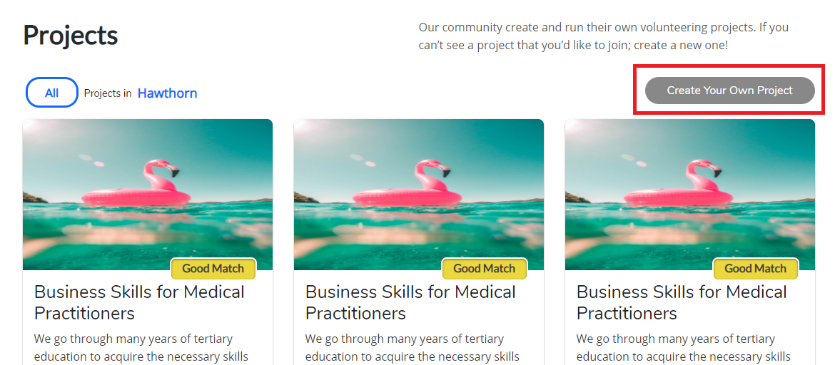
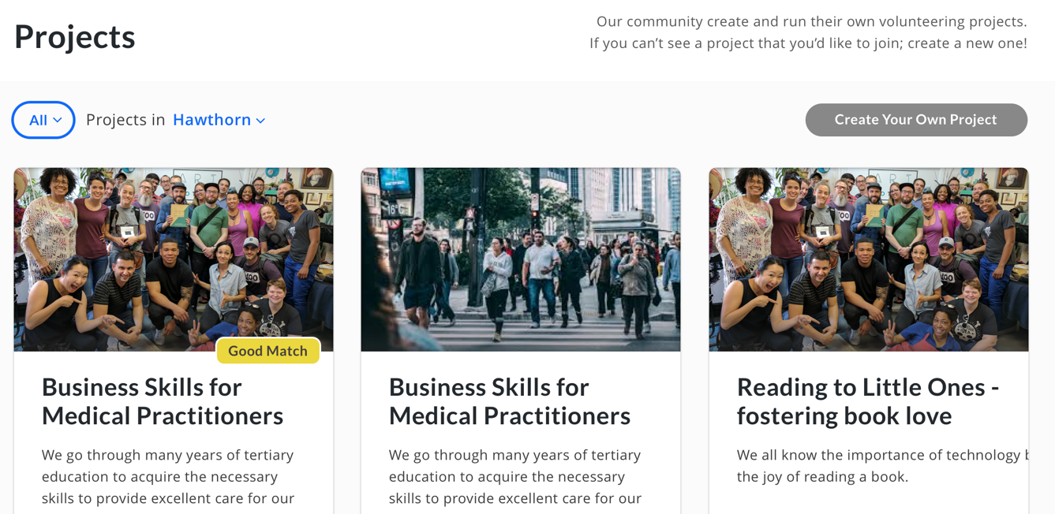
Q1: Project List (1)
1-1 Is it possible to click ‘create project’ on project list page? I mean creating project needs to be in a tribe detail.
Before knowing the tribe which can be one of project, we may not create a project.
Anyway if you want to create a project in project list page, you need to lead to a selecting tribe page or you need to add a tribe field on creating project page…

Slide 3
Thanks for reviewing my foolish questions.
dejan

